Slide 1
CULTURAL FACILITIES
S. No | Name of the Facility | Item | No. of items available
1. | Cultural Events | Drum Set | 01
2. | Cultural Events | Speakers | 2
3. | Cultural Events | Wall Speakers | 14
4. | Cultural Events | Mic’s | 10
5. | Cultural Events | Collar Mic’s | 02
6. | Cultural Events | Amplifiers | 06

Slide 2
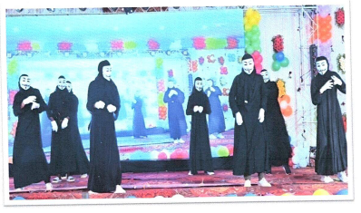
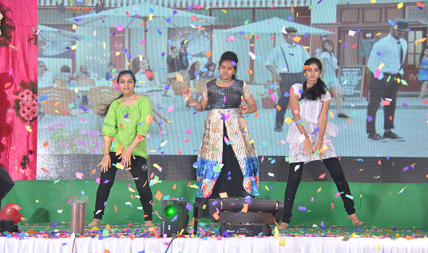
CULTURAL FACILITIES
Students Playing the Mime
Dance Performance by Girls

Slide 3
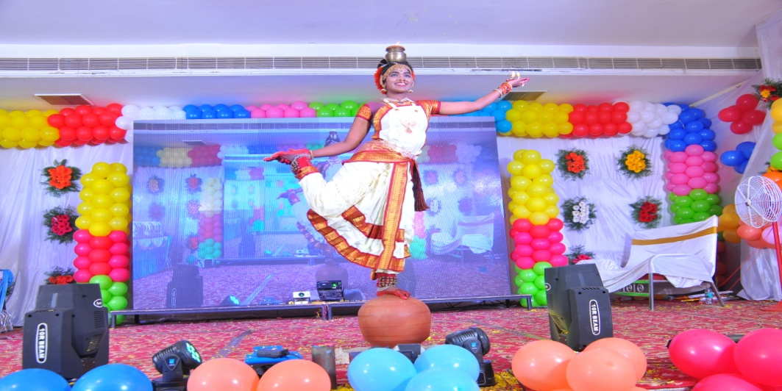
Classical dance performance

Slide 4
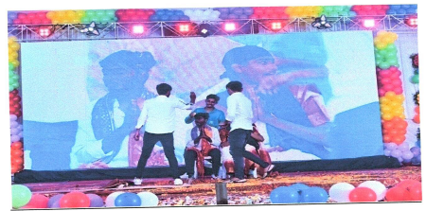
Dance performance by Boys

Slide 5
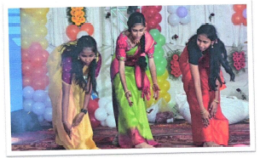
Dance performance by Girls

Slide 6
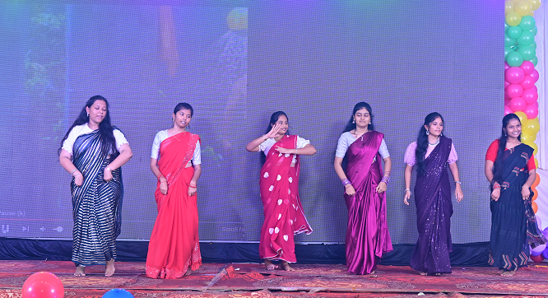
Students performing cultural activities

Slide 7
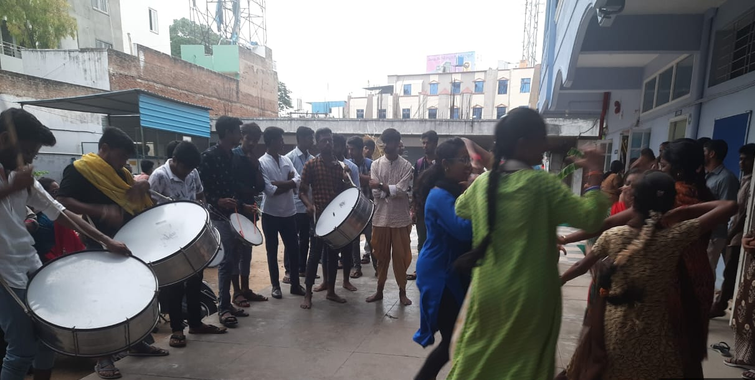
Playing Drums

